Slide 1


Better understanding the administrative culture in countries of origin
ROMANIA
Florin Moisa
ROMACT national project officer, NW Romania

Slide 2
Public Administration in Romania

Slide 3
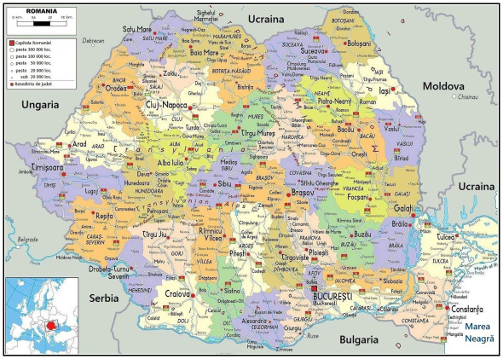
Public Authorities in Romania

Slide 4
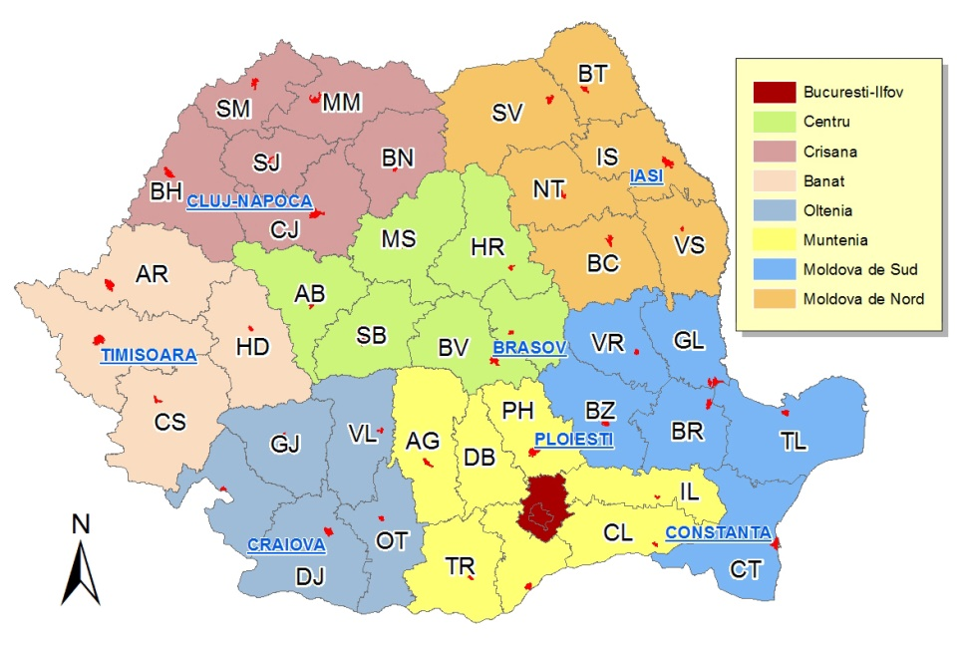
Romania development regions
Designed on the historical regions of Romania
First created in 1998 - co-ordinate regional development of Romania during the pre-accession period to the EU
Development regions consist of several counties each
Correspond to NUTS II (Nomenclature of Territorial Units for Statistics) level divisions in European Union member states
They do not have an administrative status and do not have a legislative or executive council or government

Slide 5
Romania – administrative organization
Romania
Counties (41)
Bucharest
Commune (2856)
Cities/Towns (217)
6 Sectors
Municipality (103)

Slide 6
Regional and Local
41 counties and one municipality which are assigned as NUTS III level
one city with special status Bucharest - the national capital city, with 6 Sectors each with its administration
Romania has no NUTS-4 units
Counties composed directly of cities, municipalities, communes.
103 municipalities (municipiu – larger town, no other administrative power)
217 other urban cities
2856 communes, rural areas, containing 12,955 villages which have no administration of their own
Below communal or town level, there are no further formal administrative subdivisions

Slide 7
Political power structure
Legislative – Parliament (Deputy Chamber and Senate)
Executive – Government
Judicial – court system

Slide 8
Authorities of Public Administration
The state public authorities are:
The Government;
The specialized administration:
  Ministries
  autonomous administrative authorities
  deconcentrated public services;
The Prefect.
The local public authorities are:
The County Council;
The Local council;
The Mayor;
Local public services

Slide 9
The Prefect
The prefect is a representative of the state, namely the executive office which serves to watch over law enforcement by local government authorities.
Since 1 January 2006 the prefect is part of senior civil servants
Leads deconcentrated public services of ministries and other central government bodies and administrative units.
Verification of the legality of administrative acts of local or county authorities, in the administrative court, these measures if deemed unlawful, excluding acts of management. The challenged act is suspended by law.

Slide 10
Deconcentrated public services
Territorial structures of the ministries and other central institutions:
county police inspectorates
civil protection inspectorate
county school inspectorate
general directorate of public finance
veterinary department
county statistics directorate
county sports department
directorate for dialogue, family and social solidarity
county environmental guard
county agencies for employment
county houses of pensions
county offices for consumer protection
cadastre and land registry offices.

Slide 11
The County Council
It is the deliberative authority that coordinates the activity of communal, town and municipal councils in pursuit of delivering the county public services.
The county councilors are elected by the citizens’ vote for a period of 4 years.
It ensures the organization and coherent development of public policy by adopting decisions in the county.
It meets monthly and perform tasks relative to socio-economic development, management of property and subordinated services, inter-institutional cooperation, organization and operation of the specialised apparatus.

Slide 12
The Local Council
Deliberative authority by which the local autonomy is enacted in communes, towns and municipalities and sectors.
Upon the proposal of the mayor, it issues decisions approving the local budget; it establish and approves local taxes, according to the law.
Made up of local councilors, elected by the community, for a term of 4 years.
It meets in regular (monthly) and extraordinary meetings, convened by the mayor and extraordinary meetings upon the request of the Mayor or at least one third of the councilors.
The local council meetings are public.

Slide 13
The Mayor
Executive Authority enacting local autonomy in communes, towns and municipalities and sectors, ensuring the fundamental rights and freedoms of the citizens, the Constitution, and the implementation of laws and the necessary measures;
provides support for the implementation of orders and instructions of a normative nature.
Issues orders in exercising its powers.
Elected by the local community for a term of 4 years.

Slide 14
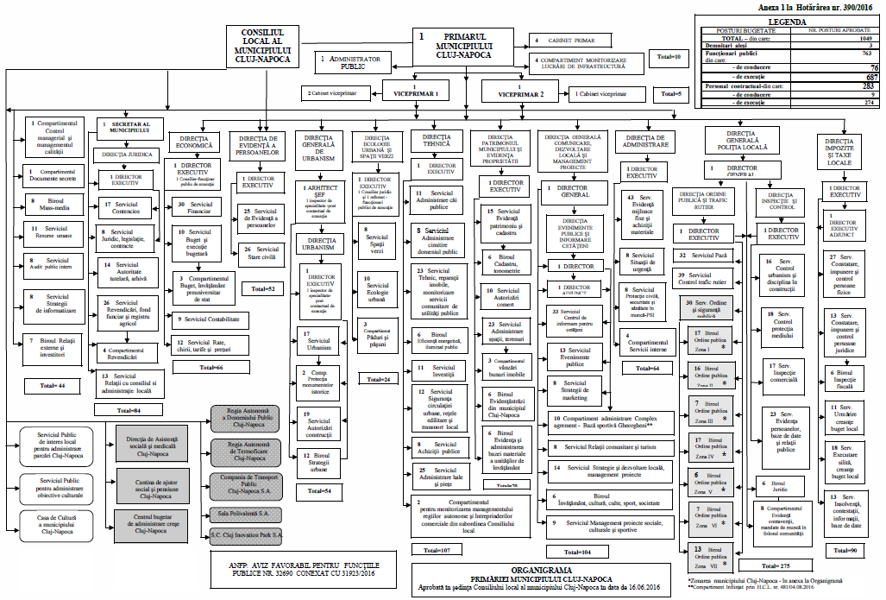
Ex. Organizational Chart – Cluj Napoca

Slide 15
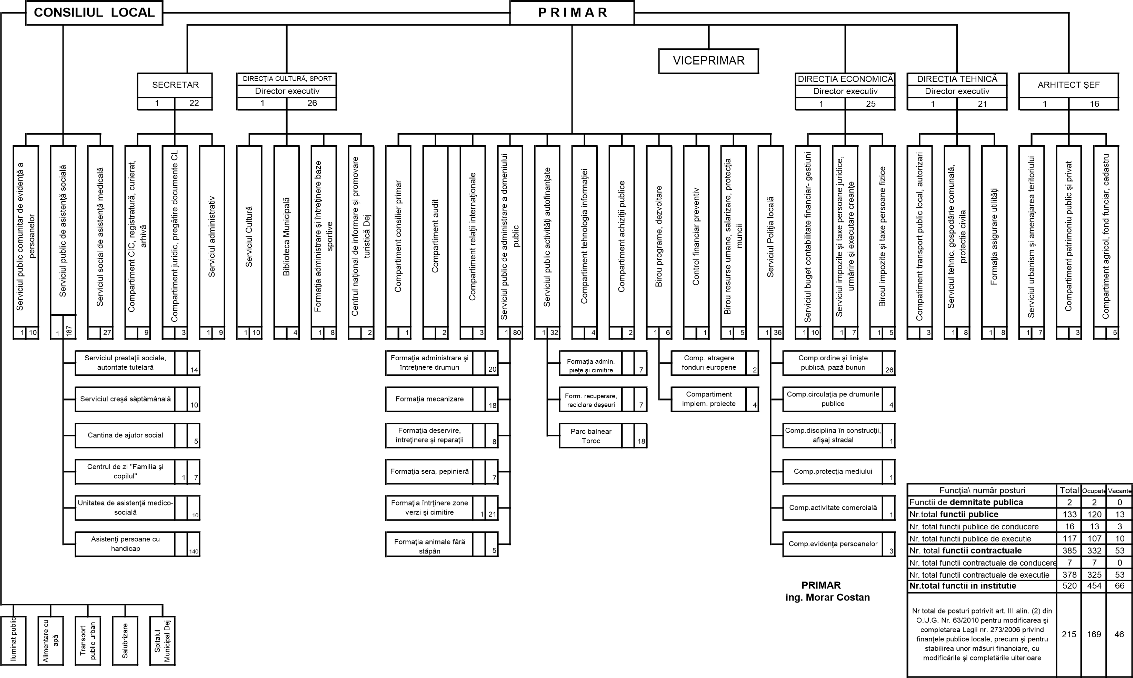
Ex. Org. Chart – Dej – small town

Slide 16
Roma situation in Romania

Slide 17
Roma in statistics
Census of Romanian Population and Households from 2011 – (621.600) 3.3% Roma
Census 2002 - the Roma population (535,140) - 2.46%
Census 1992 - 401,087 Roma - 1.75%
unofficial Roma figure is around 6.7 per cent of the total population
Year | Total population (mil.) | Roma | Romanian % | Hungarian % | Romi %
1930 | 14.28 | 242.656 | 77.9 | 10.0 | 1.7
1956 | 17.48 | 104.216 | 85.7 | 9.1 | 0.6
1966 | 19.1 | 64.197 | 87.7 | 8.5 | 0.3
1977 | 21.55 | 227.398 | 88.1 | 7.9 | 1.1
1992 | 22.81 | 401.087 | 89.5 | 7.1 | 1.8
2002 | 21.68 | 535.14 | 89.5 | 6.6 | 2.5
2011 | 20.25 | 619.000 | 88.6 | 6.5 | 3.3

Slide 18
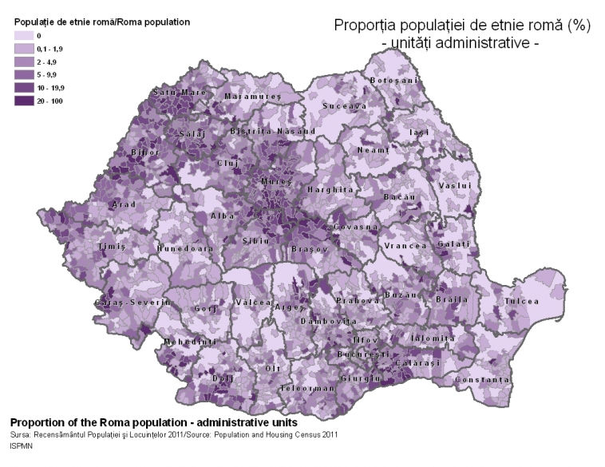
Roma in statistics

Slide 19
Roma in statistics
half of the Roma population in Romania is a young one – 253,231 Roma, meaning that 47,4% are registered between 0-19 years old.
One third of the Roma population is made up of children (0-14 years old), while the average age of the Roma is approximately twenty-four.
The life expectancy at birth calculated by some recent research, one of the most synthetic indicators describing the situation of a certain population, is showing a difference of 16.4 years less life expectancy at birth for Roma, compared to the majority of population in Romania.

Slide 20
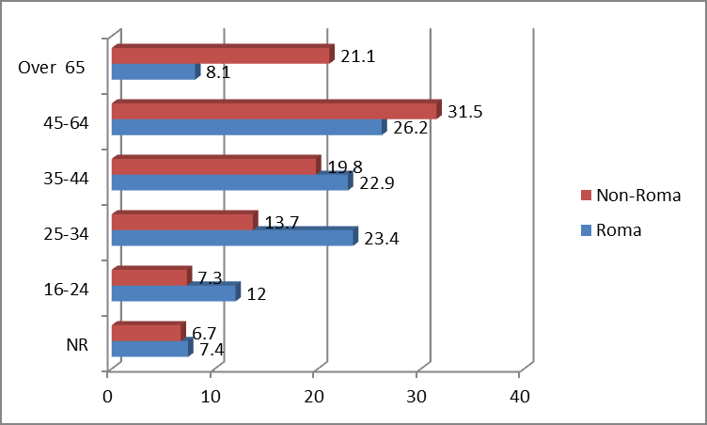
Age distribution of Roma population compared to non-Roma population living in the same area (%)
Source: The Roma in Romania. From Scapegoat to Development Engine, 2013

Slide 21
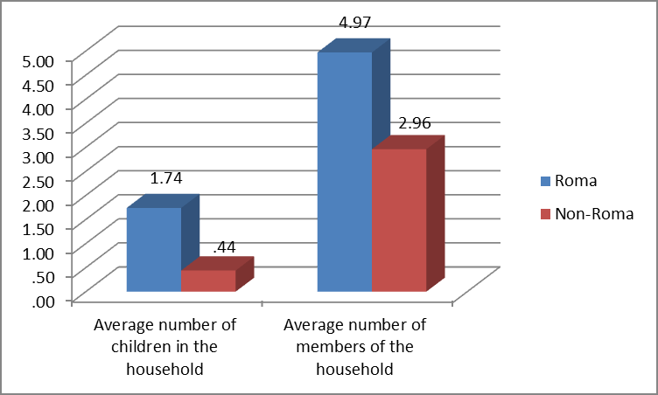
Composition of households
Source: The Roma in Romania. From Scapegoat to Development Engine, 2013

Slide 22
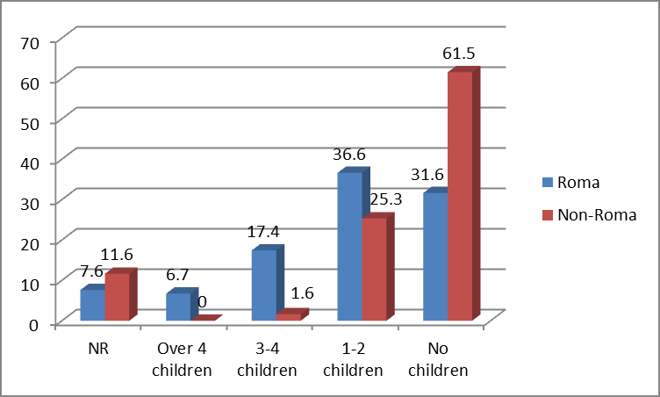
Distribution of households by number of children (%)
Source: The Roma in Romania. From Scapegoat to Development Engine, 2013

Slide 23
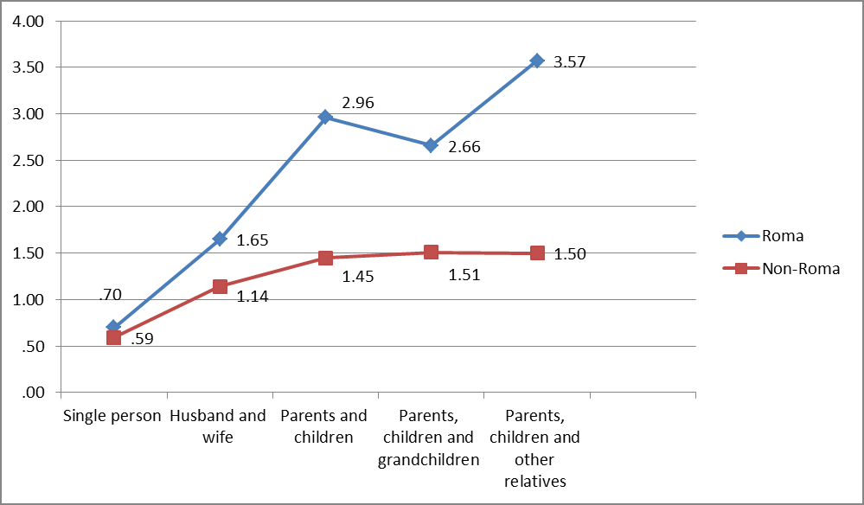
Number of persons per room by family type and ethnicity
Source: The Roma in Romania. From Scapegoat to Development Engine, 2013

Slide 24
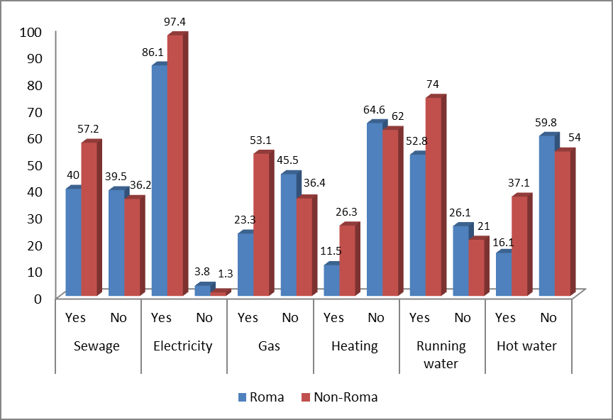
Access to utilities by ethnicity (%)
Source: The Roma in Romania. From Scapegoat to Development Engine, 2013

Slide 25
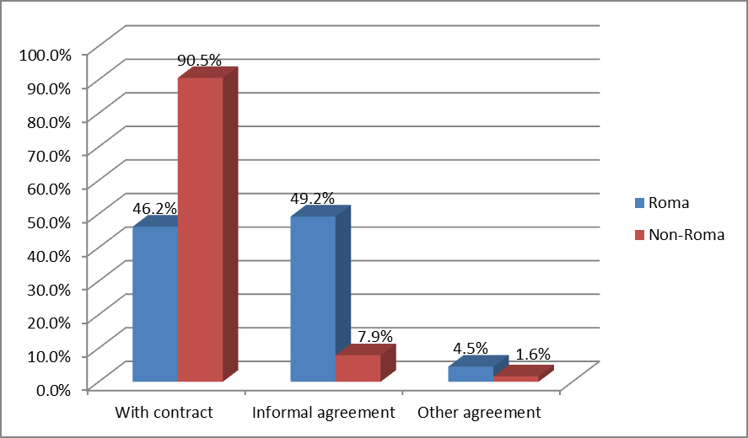
Distribution of employment type by ethnicity (formal / informal)
Source: The Roma in Romania. From Scapegoat to Development Engine, 2013

Slide 26
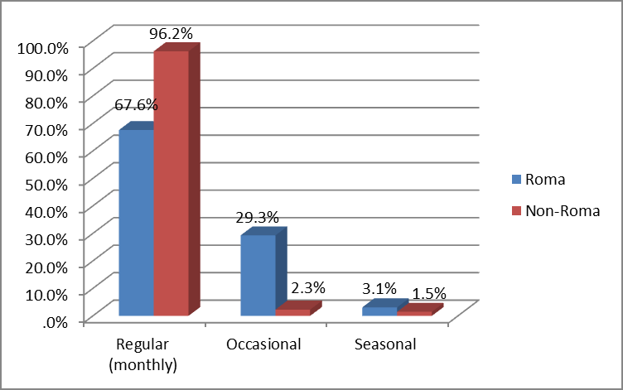
Distribution of the type of income by ethnicity
Source: The Roma in Romania. From Scapegoat to Development Engine, 2013

Slide 27
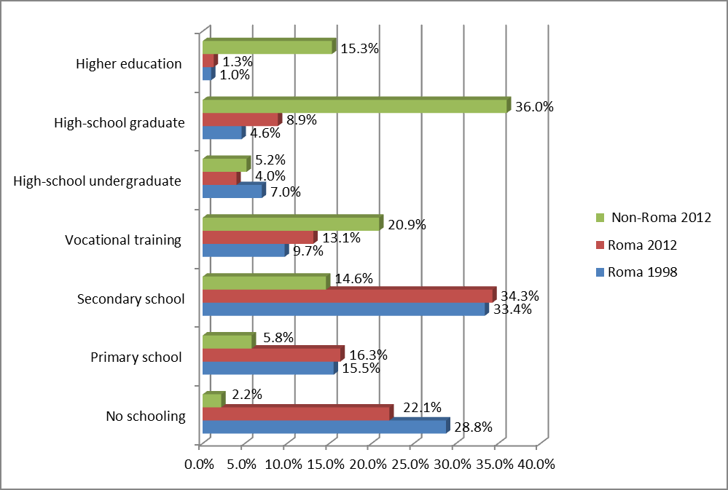
Education level by ethnicity, comparison 1998-2012
Source: The Roma in Romania. From Scapegoat to Development Engine, 2013

Slide 28
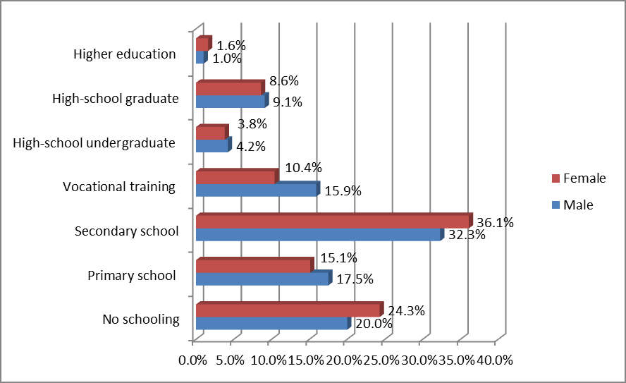
Distribution of education level in the case of Roma by gender
Source: The Roma in Romania. From Scapegoat to Development Engine, 2013

Slide 29
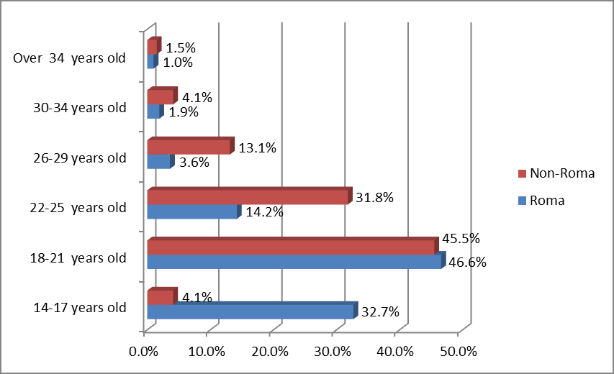
Age at first pregnancy by ethnicity
Source: The Roma in Romania. From Scapegoat to Development Engine, 2013

Slide 30
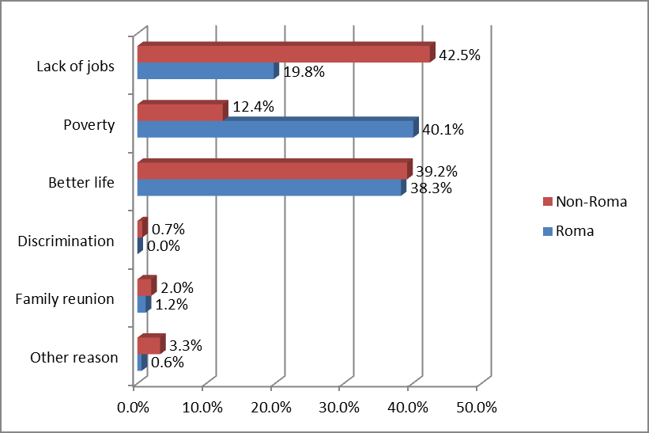
Main reason for migration by ethnicity
Source: The Roma in Romania. From Scapegoat to Development Engine, 2013

