Slide 1
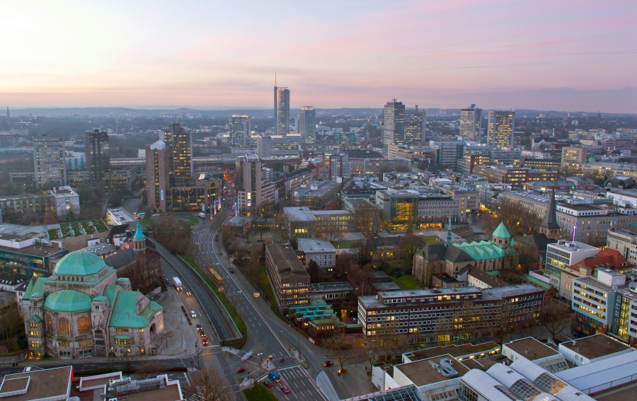

Slide 2
Content
Framework conditions
Where are the Roma people?
Projects for migrants from Bulgaria and Romania
“The children are the key”

Slide 3
The framework conditions also include:
Essen is the seat of 3 of the 30 DAX companies.
Around 80% of all jobs are in the tertiary sector.
Measured on the Ruhr area average:
  comparatively high cost of living,
  comparatively high costs for the housing rental
    and consequently relatively few scrap real estates.

Slide 4
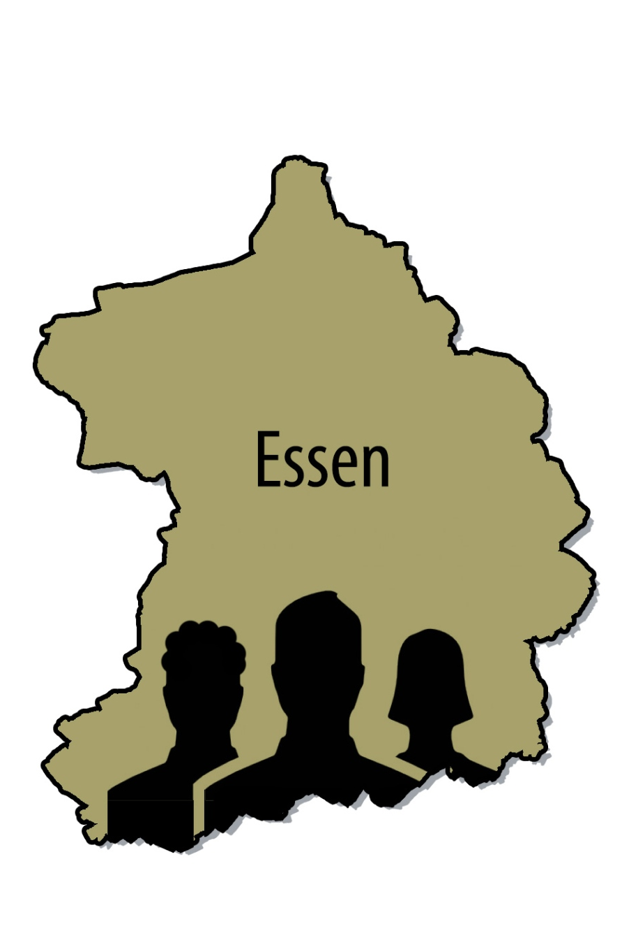
Migrants in Essen
Total population 588.875
Among them:
Dual state and
non-Germans 144.755
Among them:
from EU countries 48.959
Among them:
Bulgarians and Romans 6.608

Slide 5
Development of the Bulgarian and Romanian population figures

Slide 6
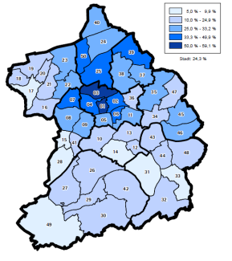
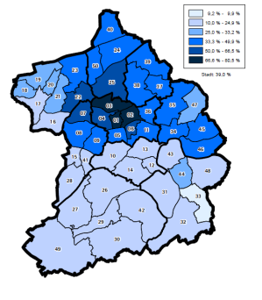
Essen is a socially divided city
Dual-state and non-Germans in the districts
Dual-state and non-Germans under 18 years of age in the districts

Slide 7
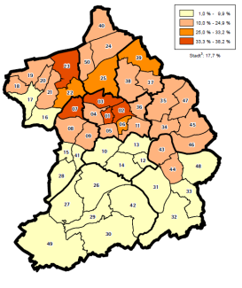
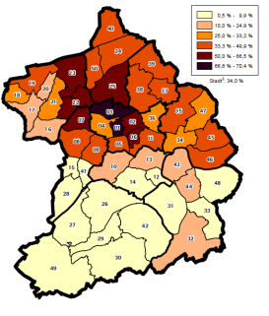
Essen is a socially divided city
Persons under 18 years of age with social welfare
Persons with social welfare

Slide 8
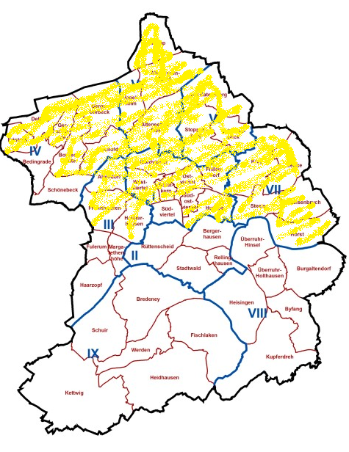
Distribution of the Bulgarians and Romanians in the districts
More than 1% of the population
Less than 1% of the population

Slide 9
Distribution of the Bulgarians and Romanians in the districts
More than 2.5 %
of the population

Slide 10
But where are the Roma people?
We just didn't know.

Slide 11
There is no data on ethnicity

Slide 12
There is no data on ethnicity
In North Rhine-Westphalia an estimated 35,000 German Sinti and Roma live.
This results in estimated for the city of Essen 1,200.

Slide 13
There is no data on ethnicity
In North Rhine-Westphalia an estimated 35,000 German Sinti and Roma live.
This results in estimated for the city of Essen about 1,200.
There are estimates from the community itself that in Essen about 500 Roma from ex-Yugoslavia live.

Slide 14
There is no data on ethnicity
In North Rhine-Westphalia an estimated 35,000 German Sinti and Roma live.
This results in estimated for the city of Essen about 1,200.
There are estimates from the community itself that in Essen about 500 Roma from ex-Yugoslavia live.
No one perceives them because they are fully integrated.

Slide 15
And how many Roma from South-East Europe live in Essen?
We can only
appreciate that.

Slide 16
A clue:
Consulting for parents and children to enter school in Essen
First language of the child

Slide 17
Projects for migrants from Bulgaria and Romania –
not specifically for Roma
First reflections in late summer 2013.

Slide 18
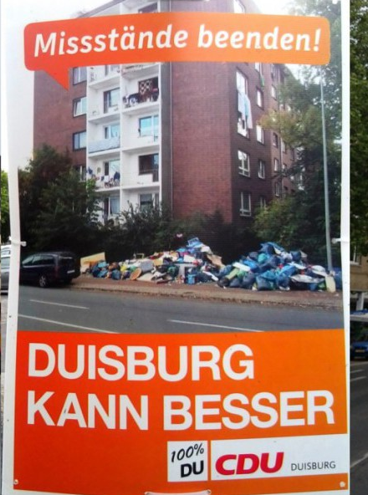
Projects for migrants from Bulgaria and Romania –
not specifically for Roma
First reflections in late summer 2013.

Slide 19
Projects for migrants from Bulgaria and Romania –
not specifically for Roma
First reflections in late summer 2013.
Start 2014.
Since then steadily expanded.

Slide 20





Slide 21
Numerous other network partners:
Church communities
Other welfare associations
Voluntary working doctors
Jobcenter, Youth office
Regulatory authorities, Police
District conferences
…

Slide 22






Slide 23
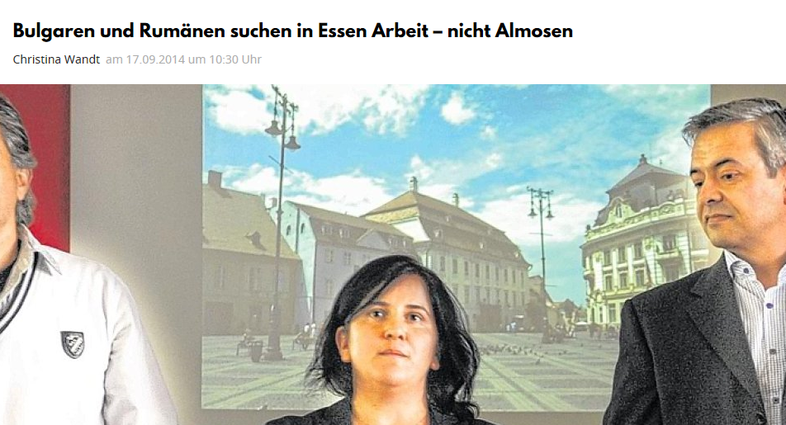
Mostly affirmative press reports in Essen

Slide 24
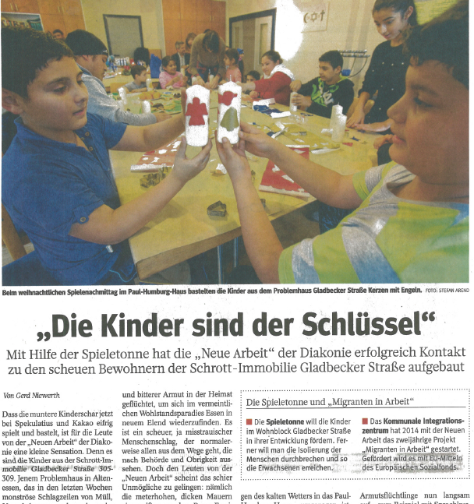
Mostly affirmative press reports in Essen

Slide 25
Versatile approach to the target group:
“The children are the key”

Slide 26
Versatile approach to the target group:
The children are the key
Social Coaches
  Outreach work
  Advice at home
  Help finding an apartment
  …
Integrating agents
Low-threshold language courses
Mediation into the labor market

Slide 27
Distribution of the Bulgarians and Romanians in the districts
More than 2.5 %
of the population
In these districts also the majority of the Roma from South-Eastern Europe live.

Slide 28
Clues:
We have awakened confidence
Constantly growing proportion of Roma who take counsel

Slide 29
Clues:
We have awakened confidence
Constantly growing proportion of Roma who take counsel

Slide 30

Thank you for your attention.

