Slide 1
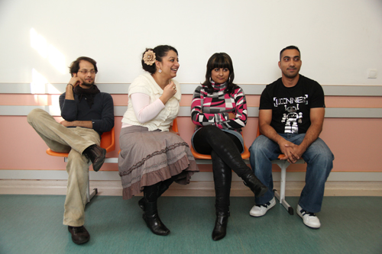
Roma in Glasgow
Gordon Smith
Glasgow City Council
Notes:
Good morning everyone, my name is Keith Moore-Milne and I am the Roma Children & Families Team Leader for Glasgow City Council Social Services. I would like to welcome everyone here to this event. Today I am standing in for Marie Mclellend Roma Projects Manager for DRS. Andy McArthur is going to set the scene for you for the rest of today’s Workstream 4 meeting. My job is to give you some idea about the work we, as a council, are doing with the Roma community in Glasgow.

Slide 2
New migrants mostly
from Slovakia or Romania
Notes:
Most of the Roma people in Glasgow have come from two distinct areas of Europe – Eastern Slovakia and Western Romania.

Slide 3
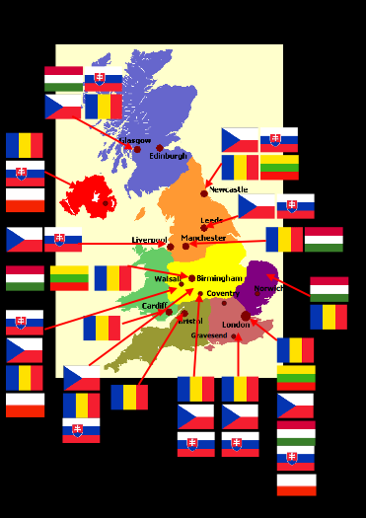
ROMA IN UK
Roma initially arrived in UK following EU expansion between 2004 and 2007
Around 225,000 living in UK
Predominantly urban and living in multi ethnic areas

Slide 4
ROMA IN SCOTLAND
6,000 estimated Roma in Scotland – 4,000 in Glasgow.
Predominantly Slovakian and Romanian
Also some Czech, Bulgarian, Polish, Latvian
Notes:
In 2013, Glasgow commissioned a mapping study of Roma in Scotland. This was the first study of its kind and the aim was to get the most accurate information we could on Roma living in the country.
The mapping study established that there are around 5,000 Roma living in Scotland of which around 3,500 are living in Glasgow – mostly in Govanhill. They are mostly Slovakian and Romanian but there are also small pockets of Roma in the City from the Czech Republic, Bulgaria etc.

Slide 5
ROMA IN GLASGOW
Concentrated in Govanhill – South East of City.
Long history of migration here – most ethnically diverse community in Scotland (45%).
57 languages spoken
Notes:
Since arriving in Glasgow, Roma have predominantly settled in the Govanhill area of the City. This has been describes as Glasgow Ellis island as it has a long history of migration here. This is mostly due to the housing situation – there is a lot of private, easily available apartment to rent.
As a result, Govanhill is not only one of the most densely populated areas of Scotland, it is also the most ethnically diverse with over 57 language spoken.

Slide 6
Glasgow has long history of social and economic inclusion activities but….Poverty remains with multiple barriers…SIMD 2016 data
Notes:
Glasgow has known poverty for a long time. Many people from Glasgow remember the slums of the 1930’s and 1940’s in Glasgow where poverty was absolute.
However over many decades, Glasgow has implemented social inclusion project that have helped alleviate this poverty.

Slide 7
BARRIERS FACED BY ROMA
Health & Social Care
Infestation and malnutrition;
Poor Health indicators
Registering with GP can be daunting;
17% of children are open cases to Roma Children & families Team
80% of referrals due to poverty
Notes:
Most of the health issues faced by Roma relate to low levels of poverty. Poor housing etc has a significant impact and there is also an issue around language, most just do not have the right support to engage with health services.

Slide 8
Dedicated environmental health team
G.P’s now have translation facilities
First point of contact
Projecting 850 new registrations 2016
Dedicated Roma children and families team
Dedicated Welfare Rights officer - secured £1.2m in benefits for Roma migrants to date

Slide 9
Case Study:
Many Slovakian and Romanian Roma children in primary and secondary schools were not in receipt of free school meals or clothing grants.
Social work referrals from local schools – children often hungry, taking food from bags and children arriving at school cold and wet – inadequate clothing for Scottish winter
Approximately 500 children over 4 primary schools- only 25% in receipt of free school meals/clothing
Joint intervention: Education/Social Work/3rd Sector- now 37% in receipt
25 directly parent engaged-Peoples Health Trust-9yrs funding

Slide 10
BARRIERS FACED BY ROMA
Education:
Low levels of attainment/attendance;
Struggle to adapt to different educational framework;
Obvious language barriers;
Previous history of segregation leads to apprehension.
Low aspirations
Notes:
Historically, Roma have been excluded from education and this has meant low levels of attendance when they come to the UK. This is often because they come from households where no-one has attended school, literacy and english is poor and they therefore cannot support their children in school.

Slide 11
657 Roma children now in Education
Primary school attendance 86%
Secondary school attendance 76%
We anticipate that in excess of 50% of the Roma children in secondary education will go on to further education
Using family learning model for adults
Big Noise

Slide 12
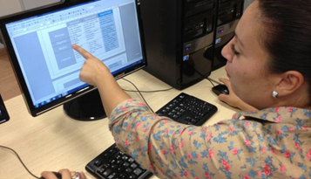
EMPLOYMENT BARRIERS
Access low paid work with poor conditions;
Language is a barrier to work;
Many have issues with literacy and numeracy;
Welfare reform – limited financial support when out of work – working on grey economy only alternative;
Notes:
Employment is often the main pull factor for many Roma but once here, they suffer from multiple barriers that prevent them accessing the labour market. Language being the number one issue. Many roma end up in low paid, volatile employment.
Language support is also an issue. As many are illiterate, the current english language courses are not fit for purpose as they assume that the learner is literate in their first language and with Roma this is not always the case.
There have also been issues with exploitation of workers being reported.

Slide 13
Roma employability initiative
874 clients engaged with
526 received work relate training
192 gained a qualification
169 went in to employment
Currently under review

Slide 14
BARRIERS FACED BY ROMA
Housing:
Poor, overcrowded conditions;
Confusion over entitlement to help with housing costs;
Vulnerable to exploitation from landlords;
No tenancy agreements means less protection – illegal eviction.
Notes:
The housing conditions of Roma are mostly below tolerable standard however it is worth noting that the are considerably better here than those where they came from.

Slide 15
Housing Acquisition pilot- 2yrs £13.5m
Enhanced enforcement powers
Landlord accreditation scheme
Rights support team within pilot
Multi agency hub
Govanhill Action Plan
Govanhill Partnership

Slide 16
Acquisition programme proposals

Slide 17
Acquisition programme pilot: 4 blocks/ 76 closes/576 units
Proposed next phase: 16 blocks/ 233 closes/ 1905 units
Enhanced enforcement area to be extended
Compulsory purchase to be considered
Factoring to be expanded
Includes refurbishment of acquired property
No displacement of tenants

Slide 18
Our Roma need exceptional support
Effective integration/inclusion needs a multi-agency approach
All barriers must be tackled
There may well be substantial costs for the City
There is no quick solution
Long term strategy and buy in required

