Slide 1
ROMACT PROGRAMME Better understanding the socio-cultural specificities of Roma originating from the South East of Europe http://coe-romact.org/
Lisa Rose
ROMACT Trainer

Slide 2
ROMACT Socio-Cultural Component
There are both openly hostile and exoticising representations and perceptions about Roma people.
One of the aims of the training is to demonstrate the “normality” of Roma people framed by their historical and current experiences in Europe.

Slide 3
ROMACT Socio-Cultural Component Why is it Important?
Socio-Cultural Information presented correctly can give a basis for understanding some of the influences that may mediate an individual’s relationship to their context.
It can offer some guidelines to how people might be processing and organising their experiences.

Slide 4
ROMACT Socio-Cultural Component Why is it Important?
In the delivery of this component, participants are reminded to be mindful that Culture is a dynamic process that can be like a river with a number of currents moving at different rates and intensities (Yuri Lotman)

Slide 5
ROMACT Socio-Cultural Module Topics Covered
Gender Issues & Roles
Roma Categories
Social Organization
Leadership Structures
Relations with Outsiders
Education & School Attendance
Birth, Weddings & Death Customs & Traditions

Slide 6
Better understanding the socio-cultural specificities of Roma originating from the South East of Europe

Slide 7
Roma Communities remain an oppressed and marginalised group
Many Roma people avoid assimilation with the larger societies of their host countries — this may be a legacy of centuries of persecution.
Because of their isolation, many Roma children do not attend school; Roma people typically lack access to stable jobs, affordable housing, health care and other social services. As a result, poverty, disease, substance abuse and crime plague many Roma communities.

Slide 8
The Situation of Roma in Southeastern Europe

Slide 9
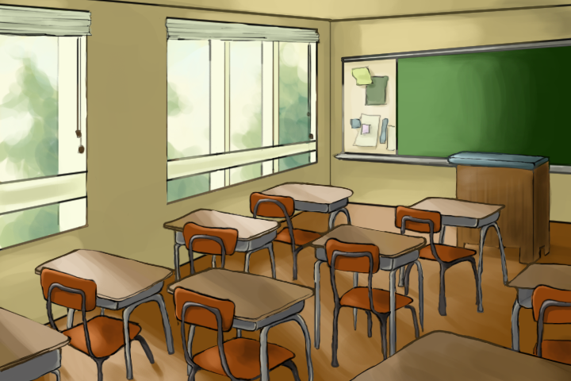
Roma In Education
On average, only one out of two Roma children attend pre-school or kindergarten
During compulsory school age, with the exeption of Bulgaria, Greece and Romania, 9 out of 10 children aged 7-15 are reported to be in school.
Participation in education drops considerably after compulsory school. It is estimated that 15% of young Roma adults surveyed complete upper-secondary general or vocational education.

Slide 10
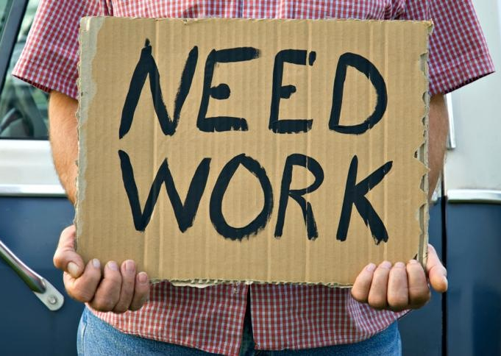
Roma in Employment
On Average, fewer than 1 out of 3 Roma are reported to be in paid employment (less than one third).

Slide 11
Roma in Health
On average, 1 out of 3 Roma aged between 35-54 report health problems limiting their daily activities
Roughly 20% of Roma are not covered by medical insurance or do not know if hey are covered

Slide 12
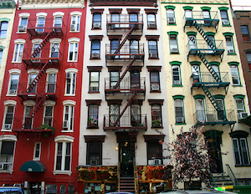
Roma in Housing
On average, in Roma households, more than 2 people live in one room.
About 45% of the Roma live in households that lack at least one of the following basic housing amenities, namely indoor kitchen, indoor toilet, indoor shower or bath and electricity.

Slide 13
Poverty in Roma Communities
On Average about 90% of Roma live in households with an equavalized income below national poverty lines.
Access to civil documentation is also limited, many Roma lack basic documentation which prevents them from enjoying basic rights and from accessing benefits in their country.

Slide 14
Discrimination and Rights Awareness of the Roma
Roughly 50% of people in the Roma community have experienced discrimination in the past 12 months because of their ethnic background.
Around 40% of the Roma surveyed are aware of laws forbidding discrimination against ethnic minority people when applying for a job.

Slide 15
UNDP 2016 – Micro Stories Research
Currently Collecting micro-narratives from the Southeast Region – 200 stories in 6 countries.
One of the components being studied is re-integration narratives.
The initial results are that for these communities, returning has increased:
social and economic insecurity,
Disrupted education
Unemployment and lack of housing
Lack of social protection and healthcare services

Slide 16
Broad Socio-Cultural Picture
The Roma are not a single homogeneous group of people. They can include:
Ashakli (Kosovo)
Egyptians (Albania)
Beyash (Croatia)
Romanlar (Turkey)
Kalderash (Romania and Ukraine)
Lovari (Romania, Croatia, Slovakia)
And More….
(The countries noted are not the only countries of residence/nationality/origin for these groups)

Slide 17
Roma Religions
The Roma do not follow a single faith, for example, in broad terms you will find that:
Manouche, Sinti, & Mercheros are Catholic
Ashkali and Romanlar are Muslim
Kalderash and Lovari Pentecostal

Slide 18
And yet there are some similarities
Roma have a common lexicon, or language, in differing dialects called Romani
There are common notions around the need to follow codes of cleanliness.
There are broadly common Roma cultural behaviors and similar world views.

Slide 19
Roma Leadership Structures
The family is the most important unit in Roma society.
Generally speaking, the role of the head of the household is the most important person, traditionally it is the eldest man in the extended household (though sometimes it could be a son)

Slide 20
Roma Leadership Structures
Kris is a Roma court institution, an entrusted internal community conflict resolution system.
The primary function of a Kris is to secure agreement between two conflicting parties to a compromise solution to community problems (mediation).
A Kris can also impose penalties.

Slide 21
Gender Issues in the Roma Community
One of the most significant aspects to note with regard to women in the Roma community is that they are generally unequal to men.
The traditional Roma family is fully patriarchal, the woman is subordinate to the men of the family and there is a clear division of work between men and women.
Traditionally the man provides for the family and represents the family to outsiders.
The woman’s role is mainly to take care of home, family and the passing of traditions.

Slide 22
Gender Issues in the Roma Community
Roma girls begin to take on adult caring roles at about 11, as this role increases school attendance can become less frequent.
Generally women are expected to marry young and have large families.
Roma traditions with regard to women can obstruct them from taking part in public life

Slide 23
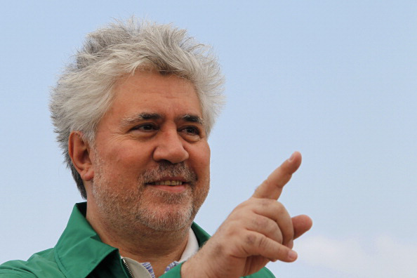
Roma Relations with Outsiders
Roma economic activities are traditionally a non-self-sufficient economy, it is based on trade and service which depends on a continuous relationships with outsiders.
The dominant relationship to outsiders is realized in the exchange of goods and services.

Slide 24
Roma Relations with Outsiders
In general the marginal position of Roma communities is, in some ways, compensated for through a feeling of superiority framed in the distinction that non-Roma are lacking in morals and honor.
The strict codes for communities, in things like cleanliness and purity, are some of the ways that the community distinguishes itself from outsiders and maintains pride in their identity.

Slide 25
Roma Views of Formal Education
Traditionally Roma families educate their children by allowing them to participate in all family activities (including economic).
In the broad view of the adult community, formalized schools are non-Roma institutions.
They represent non-Roma social norms and ideas, like rigid rules, obedience to non-Roma authority, oppression of children’s creativity, and separation of child from family for long periods of the day.

Slide 26
Roma views of Formal Education
However, it is recognized that school cannot be avoided at younger ages and there is a recognition that numeracy and literacy skills are useful in wider society.
Often their reluctance to include their children in schools is reinforced by discriminatory institutional practices, which only encourages further suspicion and concern for family’s sending their children to formalized schooling.

Slide 27
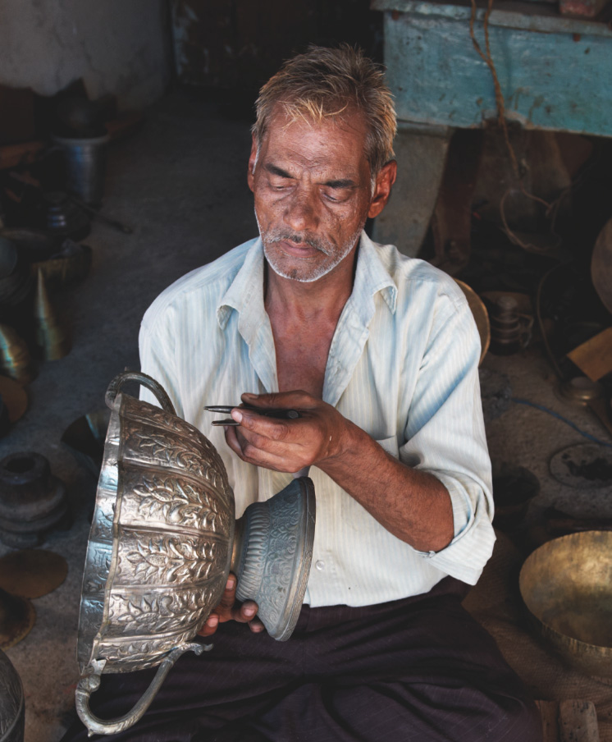
Roma Traditional Occupations
Roma Groups often have similar occupations, drawing upon traditions of peripatetic and mobile economies that exploit niche markets, such as peddling, metalwork, woodwork and trading livestock.
Roma artisans have also made livings from repairing items deemed to be “uneconomic” to mend.

Slide 28
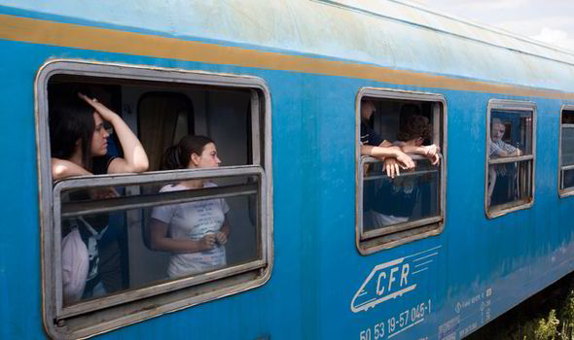
Roma and Mobility
Mobility has, for many Roma, been a part of their community identity.
But not for all, for some, they are part of more permanent lives – in agriculture, artisan skills, automobile trading, road repairs, metal work, roofing, producing crafts (furniture, woodwork, weaving).

Slide 29
How Can This Information be Useful to Institutions and Policy Makers?
ROMACT Trainings assist the participants to identify areas specific to their service delivery. These issues are also specifically addressed in the last session of the day.
In addition to specific issues raised, additional considerations relevant to the day’s activities may include some of the following areas for discussion.

Slide 30
Education & Unemployment
Is attention being paid to Roma children participation in early childhood education?
Do they focus sufficiently on supporting Roma community members in the transition from primary to secondary education?

Slide 31
Education and Unemployment
Do they pay attention to school completion rates of Roma at all educational levels - particularly in localities where there is a high concentration of this community?
When addressing Roma unemployment is attention being paid to their education status and skills?
Is training addressing skills deficits in the community?

Slide 32
Housing & Health
Are there aspects to housing in your municipality that are more acute for the Roma?
Are they taken in to consideration in engagement and outreach efforts?
Is attention being paid to the improvement of the health conditions of Roma and to ensuring equal access to health provisions?

Slide 33
Poverty and Discrimination
Is poverty addressed comprehensively targeting Roma explicitly but not exclusively and taking into account the needs of both Roma and non-Roma?
Is general attention paid to the need to combat discrimination and anti-gypsyism and to improve equal access to education, employment, housing and healthcare services?

Slide 34
Poverty and Discrimination
Is anti-discrimination, raising awareness on fundamental rights within the community (and in the wider community) being done?
Are efforts being made to address to provide an environment where people will feel confident to report discriminatory treatment and fundamental rights abuses?

Slide 35
Questions, Answers & Discussion

Slide 36
Photo from an exhibition entitled Barvale by Dusko Miljanic a Montenegrin photographer. This exhibition opened in Podgorica, Montenegro in 2010 with the backing of the government and United Nations organizations with a presence in Montenegro, including the UN refugee agency. The exhibition comprised of 32 colour portraits of Roma, including two children, who have been successful in their lives, including musicians, chefs, sports stars, politicians, actors, an business people.

