Slide 1
Natasja Naegels Policies towards (Roma) inclusion in Antwerp, Belgium
Atlas vzw
Integratie en Inburgering Antwerpen
München, December 15th 2016

Slide 2
Atlas?
Integration and diversity
Focus on individuals
Focus on organisations
Notes:
Bifolded focus : on individuals (we offer integration courses to people who are new to Flanders , dutch classes, coaching towards a job, a school) – organisations: accesible for people from divers backgrounds (positive or base on encountering problems)

Slide 3
Antwerp

Slide 4
518 368 inhabitants
Antwerp

Slide 5
518 368 inhabitants 46,9 % other ethnic origins
Antwerp
Notes:
243 009 foreign ethnic origins

Slide 6
Antwerp
Notes:
Younger generations: ¾ foreign ethnicity

Slide 7
518 368 inhabitants 46,9 % other ethnic origins Number of Roma?
Antwerp

Slide 8
518 368 inhabitants 46,9 % other ethnic origins 4500-5000 Roma (est.) = less than 1 %
Antwerp
Notes:
Small numbers – but there is a roma team!

Slide 9
Roma
Profile of Roma in Antwerp
Arriving since end 90s Refugees (Kosovo) Others (Macedonia, Bulgaria)
very diverse
land or region of origin
status of residency
socio-economic level
religion
etc.

Slide 10
(Some) Roma stand out
Notes:
No moroccan team, turkish team, nigerian team…. Roma stand out and need special attention; their problems and needs are so complex and specific

Slide 11
We need a specific approach
Notes:
Traditional ‘migrant’ approaches don’t work ; comes in the romateam
our methodology: external motivation
where we focus on education: education = key to connect with our society
which we advocate through different strategies

Slide 12
The Romateam
Schoolmediators:
→ in the field
Me:
→ facilitate the mediators
→ structural change in the context
Notes:
Explicitly targeting Roma. Which consists of 4 people – all at the same level – me: political lobbywork, training organisations, advise and coaching, casemanagement

Slide 13
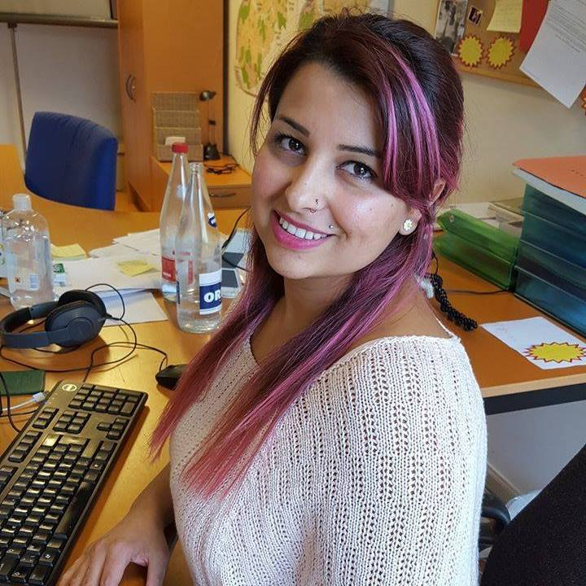
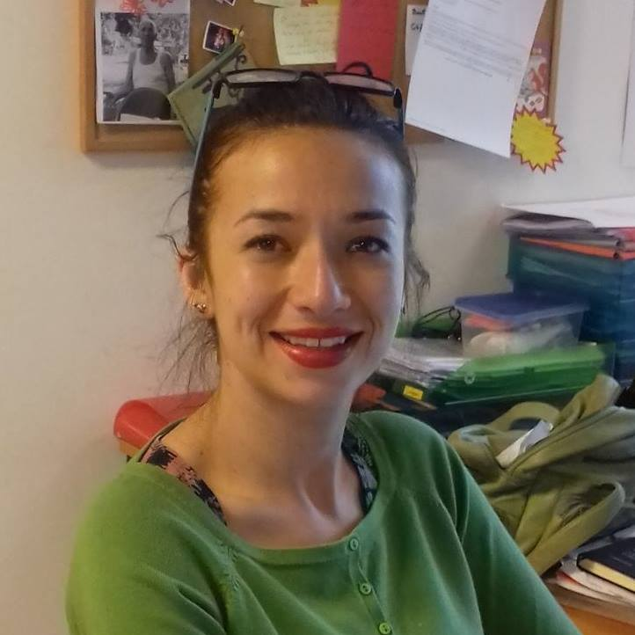
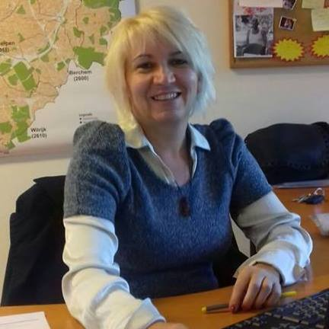
Schoolmediators
Merima
Manuela
Mirjana

Slide 14
Problems
Truancy and non schooling (most frequent)
Enrolment
Behavioural issues
School results
Etc.
Often a combination of: truancy/behaviour/parent participation/school results/referral to special needs school/practicalities/etc.
Pandora’s box.
Notes:
Contents of pandora’s box

Slide 15
Numbers
52 schools
2015-2016
231 applications
Secundary schools
34 % regular
66 % special needs
Primary schools
72 % regular
28 % special needs
112 ♀
119 ♂
Notes:
To point out two things:
Equal girls and boys
Special needs school: double in secundary school

Slide 16
Problems
Girls drop out of school early
Notes:
Which consists of 4 people – all at the same level

Slide 17
Approach
1. Strategic individual approach
2. Case management
3. Working group
4. City wide plan
Notes:
Which consists of 4 people – all at the same level

Slide 18
Structural approach
Creating a city-wide plan to address
(forced) early marriage of Roma girls
Notes:
Which consists of 4 people – all at the same level

Slide 19
Goal: moving in the same direction
Notes:
Goal: get as many people as possible alligned with our approach (schools, police force, welfare organisations, city council employees,etc)
training people who work with Roma
Political lobbywork to change the policies
Media attention (but we can’t bite the hand that feeds us…)

Slide 20
Goal: moving in the same direction
As many organisations as possible * alligned with approach (education, welfare organisations, city council, police force, justice system).
* 12 organisations involved
Notes:
Goal: get as many people as possible alligned with our approach (schools, police force, welfare organisations, city council employees,etc)
training people who work with Roma – no more cultural discussions
Political lobbywork to change the policies
Media attention (but we can’t bite the hand that feeds us…)

Slide 21
Key take-away:
Everbody shares the same vision and approach
Notes:
Implement new approach as soon as Roma become visible
Benefits Roma = benefits the whole society!

Slide 22
Thank you

