Slide 1
Romact
How to organize inclusion services for non-national marginalised people, including Roma
Teresa Woodall

Slide 2
Context
The city of Gothenburg has about 500 000 inhabitants
First contact with the group in 2005
First inclusion activity was in 2007
The city has a Roma inclusion strategy but only for nationals. About 10 000 Roma live in Gothenburg.
Mobile EU citizens does not have the same rights as the inhabitants regarding the social security- and healthsystem.

Slide 3
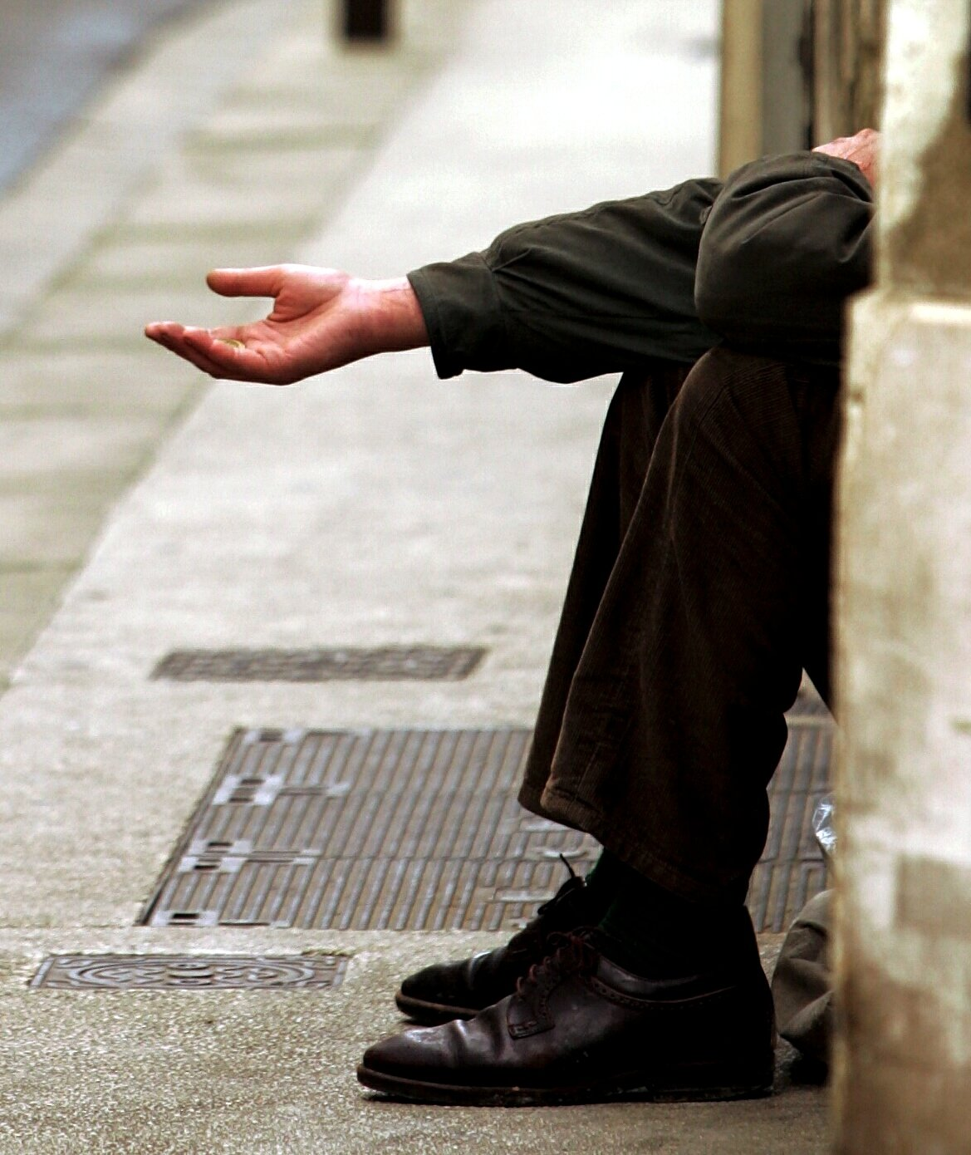
Starting point
“We know that the solution is not with us, but in the countries they come from. But now they are here and we can not pass a person in need without reacting.”
Dario Espiga, former deputy mayor, City of Gothenburg

Slide 4
Who we meet
The purpose of coming to Gothenburg is to find a way to support themselves and their families.
Most common ways to earn your living is by begging, collecting cans and selling street-magazines
About 2 000 guest has slept at the night shelter
86 % from Romania, 7 % from Bulgaria and 7 % from other EU-countries
About 25-30 % are women
1/3 of the women have children under the age of 18 at home.
Low level of education and few have work experience
.

Slide 5
Inclusive strategies / services
2007-2010 Inclusion in Swedish society for some families from Romania
2011-
Inclusion in the perspective of support and information to individuals, with special focus on the children
The City of Gothenburg as a welcoming city with equal treatment according to the obligations in law.

Slide 6
An inclusive approach in the municipality
Many departments in a municipality meet the group, so we need
Knowledge and a common approach
The aim is to enhance equal treatment and prevent the risk of vulnerability for EU citizens while in Gothenburg
Using the opportunities of the Local Government and Education Act
Outreach social work – not waiting for people to approach the municipality
Ask the group what they need

Slide 7
Inclusive services for the individual
The children´s perspective
every child has the right to education
social services with the focus “the child´s best”
Information about rights and obligations
When in need
Social services, social emergency office, social outreach workers
Day-centre
Night –shelter
Health-information (through FEAD)

Slide 8
Lessons learned (and still working on)
The political will is crucial
The willingness of the officials matter
Finding ways to cooperate with NGO´s
Building trust and relation
Cultural knowledge, the Swedish context contra other context
The picture that the municipality delivers to the surrounding environment - what concepts do we use and how do we respond

Slide 9
Teresa.Woodall@socialresurs.goteborg.se

