Slide 1
Transnational Cooperation and Capacity building for the inclusion of non-national Roma Munich 15-16 December 2016
How to integrate intercultural mediators in local administrations Dr. Nadia Ianeva LL.M.Eur. Counsellor BINNEN
ianeva@imhb.de

Slide 2
Verein für Innere Mission Bremen The Organisation
Association for the Inner Mission in Bremen
We belong to the Christian Church (Social Service) and help people who have got into a state of emergency.
-clothing store „Anziehungspunkt“
If people are in need for advice because of pregnancy
are in debt or insolvent
are a victim of trafficking in human beings and forced prostitution – the only institution in Bremen
are staying in Germany without any identification papers – postal address services -
are in danger to become homeless or are already homeless
offers for mentally disabled persons and a nursing

Slide 3
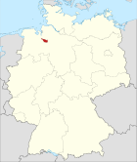
Local context Bremen and Bremerhaven
Two organisations in Bremen and Bremerhaven supported by the local authority. The Free Hanseatic City of Bremen includes the cities Bremen and Bremerhaven and is the smallest of Germany’s 16 federal states. Although two projects for EU-citizens in Bremen (BINNEN) and Bremerhaven (“dalbe”) work together on a daily base with several organizations in Poland, Bulgaria, Hungary and Romania
We cooperate with institutions and work closely with the Ministry of social affairs, youth, women, integration and sport in Bremen.

Slide 4
The Service we offer BINNEN – EHAP Project
13 experts from two EU-service centers in Bremen (BINNEN) and Bremerhaven (“dalbe”) offer people social support in their mother languages about education, health care, insurances, a place to live, the care for children, the German language, their rights or the problem of discrimination. All people and families with small children from EU-countries can get information about their new city/country and assistance to visit local authorities and the system that is in place. This service is for free.

Slide 5
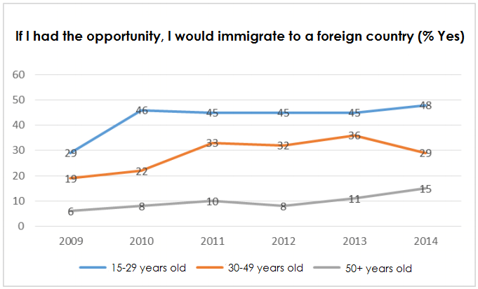
Let us research the Reasons for migration from BG to Germany Some statistical data
Permanent Immigration
ca. 2 000 000 abroad (Ministry of Foreign Affairs BG, 2011)
Source: Gallup World Poll

Slide 6
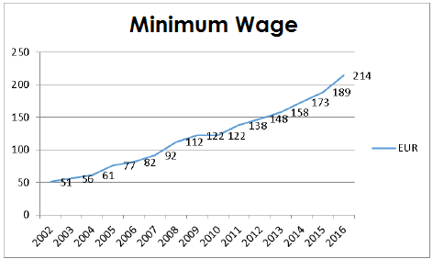
Reasons for migration from BG
Economic situation in Bulgaria
Monthly salary
The monthly salary equals to 25 working hours in Germany
Source: Bulgarian Government

Slide 7
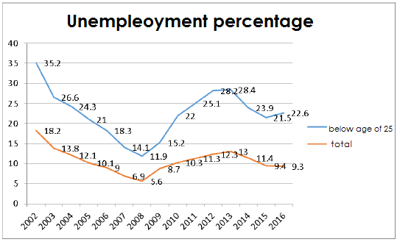
Reasons for migration from BG
Economic situation in Bulgaria
Unemployment
Two or three times higher for the jung people
Source: Eurostat

Slide 8
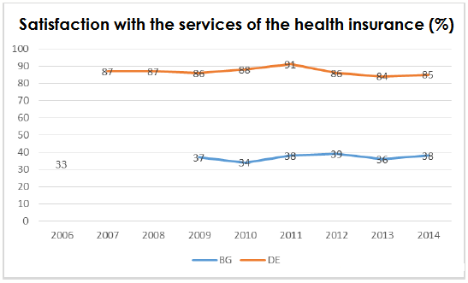
Reasons for migration from BG
Economic situation in Bulgaria
Health Care
ca. 12,5% without health insurance (Finance Office BG, 2014)
access only to the emergency
Source:
Gallup World Poll

Slide 9
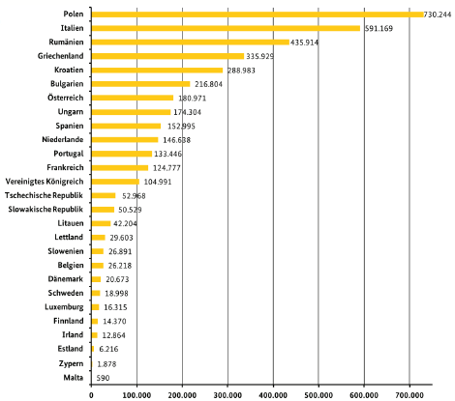
Reasons for migration from BG
Bulgarians in Germany
sixth biggest group
among the EU-States
(09.2015)
women – ca.45%
avarage duration
of stay: 4.9 years
Source: Central Register of the Foreigners

Slide 10
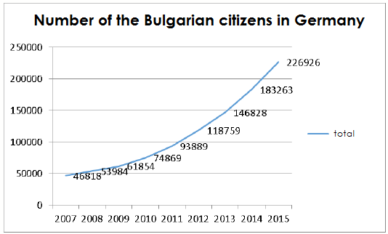
Reasons for migration from BG
Bulgarians in Germany
five times more today than in 2007
free access to the labour market since 01.01.2014
Source: Central Register
of the Foreigners

Slide 11
BINNEN
The project BINNEN has started officially in January 2016 to facilitate persons from EU-Member States in particular Bulgaria, Romania and Poland for better inclusion in the German society and faster orientation to the German education, social, civil and health system.
BINNEN works with experts who are in charge of different parts of Bremen since their tasks include to search the target group and to reach them, thus offering our assistance. We also work with volunteers that we were able to acquire in a short period of time who accompany in-migrants to the local authorities of Bremen, and help for the translation and again orientation. Some newcomers have no idea where and how to catch the tram, how to buy a ticket (if at all), where to go, what to do to open an account or how to register at the Bürger Service.
All the experts in our projects represent a multicultural team. We have experts coming originally from Bulgaria, Romania, Hungary, Poland, Russia, Italy, among other countries. We also work with many volunteers from different countries who reside in the region and work or study here.

Slide 12
Practical cases
The project in Bremen BINNEN where I am involved as a counsellor and some co-coordinating functions has 5 counsellors divided according to the regions of the City of Bremen. The project envisages Workshops and Presentations in local institutions. Since the beginning, we cooperate inter alia with the police stations, social services institutions, institutions for accommodations, schools- they all count with us as sui generis intercultural mediators already.
Cases: problems In schools, meeting the families, cases from the centre for fight against forced prostitution and human traffic; problems in the neighbourhood; communication local police-citizens

Slide 13
Help in the daily life/ inclusion
Due to our work we have helped for less than a year more than 500 new comers in Bremen, 35 % of which belong to Roma society in Bulgaria and Romania. We offer accompanying to other office hours – for example help in case of debt; a serious problem – tenancy law, housing – self-help in terms of water and electricity supply. In this case again we accompany, translate and mediate in case of conflict between the newcoming resident in Bremen and the institution, that could be the police, the city electricity supply company, telephone providers etc.

Slide 14
The postal service
Accommodation / housing problems
Problems with the Real Estate Agencies
(one registration, but many inhabitants)
Lack of administrative address
Victims of unlawful employment
- Postal service by social workers

Slide 15
About the organisation
We help EU-citizens regardless of their religion although our organisation is seen as a part of the city and part of the church
Everyone is welcome and will be assisted directly or directed to another organisation or departament

Slide 16
Need of mediators
If the consultants get the training as intercultural mediators they will interact between citizens of the two cities and the insitutions in all possible situations where the target group is faced with discrimination or issues due to cultural differences
Knowledge will be provided as to how the „German system functions“ – workshops
Presentations/ Workshops for the institutons

Slide 17
THANK YOU!
We are looking forward to our first intercultural Training in Bremerhaven/ Bremen next Monday , December 19, 2016 to see how we could implement the knowledge about Roma in Bremen

